Slide 1
Paper Title : SURVEY ON GRAPHRxINSIGHT
Authors Details
Mr. R.G. Suresh Kumar
Professor and HOD - CSE
Mrs. Elakia.K
Assistant Professor - CSE
Mr. Ganesh V,
Mr. Sriguru S
Student - UG
Rajiv Gandhi College of Engineering and Technology,
Puducherry
Paper Id : 2602167
Presenter Category : UG
Presented by
Mr. Ganesh V
Student - UG
Rajiv Gandhi College of Engineering and Technology,
Puducherry

Slide 2
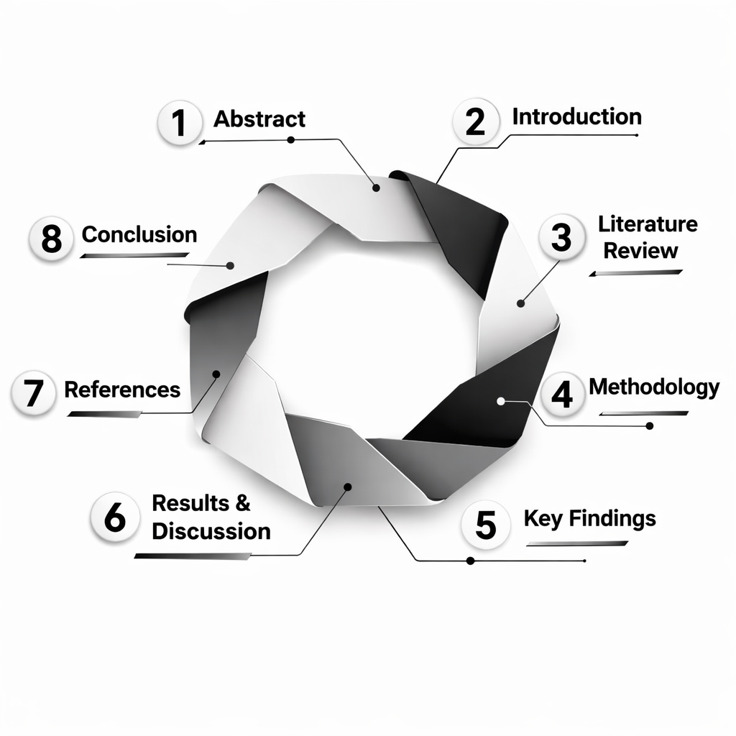

AGENDA
Abstract
Introduction
Literature Review
Methodology
Key Findings
Results & Discussion
References
Conclusion

Slide 3
ABSTRACT
Artificial Intelligence (AI), Machine Learning (ML), and Deep Learning (DL) are widely used in healthcare for analyzing molecular and clinical data to support decision-making. AI builds intelligent systems, ML enables data-driven learning, and DL, especially Graph Attention Networks (GAT) and Deep Neural Networks (DNN), extract complex features for accurate drug–drug interaction (DDI) prediction[3][8].
In existing systems to predict DDI, the models using Deep Neural Networks (DNN), Random Forest, and XGBoost with DrugBank’s structural similarity profiles are applied. They use the Synthetic Minority Over-sampling Technique to handle class imbalance in clinical datasets[6]. These approaches aim to improve the prediction of rare but critical adverse drug interactions and have demonstrated accuracy around 93.80%[3].
Even though current models provide useful insights, they have limitations in fully capturing complex drug interactions and real-world usage[2][4]. They struggle with handling imbalanced data and do not fully use Graph Neural Networks (GNN) to model multi-drug networks. We propose a hybrid model, CLINENSEMBLE, combining Graph Attention Networks (GAT), Deep Neural Networks (DNN), and CatBoost.Using chemical structure data and graph features along with clinical information, it improves rare event detection by over 5% and overall accuracy. This helps doctors and researchers better assess drug interaction risks and improve patient safety.
Keywords: Drug–Drug Interaction (DDI) Prediction, Graph Neural Networks (GNN), Graph Attention Networks (GAT), Deep Neural Networks (DNN), Polypharmacy, Ensemble Learning, Healthcare Artificial Intelligence.

Slide 4
INTRODUCTION
Drug–drug interaction (DDI) prediction is essential due to increasing polypharmacy, as undetected interactions can cause adverse drug reactions and serious clinical complications.
Existing machine learning models such as DNN, Random Forest, and XGBoost use DrugBank features and SMOTE balancing, achieving around 93–94% accuracy.
Traditional approaches treat drug pairs independently and fail to capture complex multi-drug relationships and graph-based interaction patterns.
GraphRxInsight uses a hybrid CLINENSEMBLE model combining Graph Attention Networks (GAT), Deep Neural Networks (DNN), and CatBoost to integrate chemical, graph, and clinical data.
The proposed system achieves up to 98% accuracy, improves rare interaction detection, and provides explainable predictions for safer clinical decision-making.

Slide 5
LITERATURE REVIEW
SI.NO | TITLE | TECHNIQUES | CONCLUSION
1. | Deep Learning Improves Prediction Of Drug-Drug And Drug- Food Interaction | Deep Neural Networks, Structural Similarity Profile | Based on this survey, the first paper applied deep neural networks with structural similarity profiles. We conclude that our proposed system adopts this approach and further integrates graph neural network features to improve data representation and handle imbalanced datasets.
2. | A Multimodal Deep Learning Framework For Predicting Drug-Drug Interaction Events | Graph Convolutional Networks (GCNs), CNNs, Attenstion Mechanism, Multimodal Deep Learning | Based on this survey, the second paper applied graph convolutional networks and attention mechanisms for multimodal data integration. We conclude that our proposed system uses similar techniques to generate better features for classifying rare drug interactions.

Slide 6
LITERATURE REVIEW
SI.NO | TITLE | TECHNIQUES | CONCLUSION
3. | Drug-Drug Interaction Prediction By Neural Network Using Integrated Similarly | Deep Neural Networks, Structural Similarity Profiles (SSPs), Multilabel Classification | Based on this survey, the third paper applied deep neural networks with integrated structural similarity profiles. We conclude that our proposed system follows this method and incorporates graph neural network embeddings to better generalize with imbalanced data.
4. | SSI-DDI: SubstructureSubstructure Interaction For Drug-Drug Interaction Prediction | Deep Learning Framework Called Substructure- Substructure Interaction-DrugDrug interaction (SSIDDI) | Based on this survey, the fourth paper applied sbstructure-substructure interaction modeling on molecular graphs. We conclude that our proposed system adopts this framework to address data sparsity and imbalance and enable predict.

Slide 7
LITERATURE REVIEW
SI.NO | TITLE | TECHNIQUES | CONCLUSION
5. | Prediction Pharmacodynamic DrugDrug Interaction Through Signaling Propagation Interference On ProteinProtein Interaction Networks | Propagation Interference On Protein-Protein Interaction (PPI) Networks | Based on this survey, the fifth paper applied protein-protein interaction networks modeled with graph neural networks to predict pharmacodynamic drug interactions. We conclude that our proposed system adopts this approach for robust predictions despite imbalanced data.

Slide 8
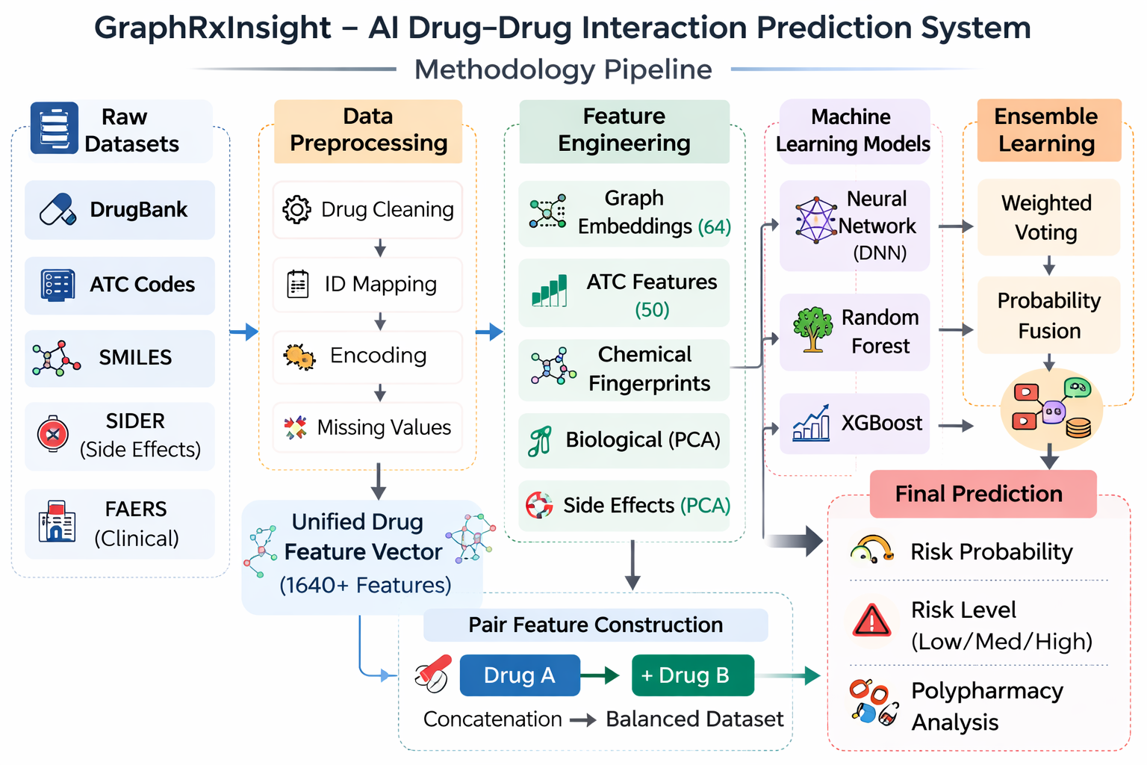
METHODOLOGY

Slide 9
METHODOLOGY
1. Data Collection: Multiple biomedical datasets were collected including DrugBank drug interactions, ATC classification codes, chemical SMILES structures, and side-effect data. These datasets provide structural, clinical, and pharmacological information about drugs.
2. Data Preprocessing: The collected datasets were cleaned and standardized by removing missing values, mapping DrugBank IDs, and converting categorical drug information into numerical format suitable for machine learning models.
3. Feature Engineering: Drug features were generated using multiple representations including graph embeddings, ATC features, chemical fingerprints, biological features, and side-effect vectors. These features were combined into a unified feature vector for each drug.
4. Model Development: Machine learning models including Neural Networks, Random Forest, and XGBoost were trained on drug–drug pair features to learn interaction patterns and predict potential drug–drug interactions.
5. Ensemble Prediction: Predictions from multiple models were combined using ensemble learning to improve prediction accuracy and reliability, producing the final drug interaction risk score.

Slide 10
KEY FINDINGS
1. Improved Prediction Accuracy: The proposed GraphRxInsight model achieved high prediction performance, reaching an accuracy of approximately 93–94%, demonstrating the effectiveness of multi-source feature integration for drug–drug interaction prediction.
2. Effectiveness of Multi-Feature Integration: Combining graph embeddings, ATC features, chemical fingerprints, biological features, and side-effect data significantly improved model performance compared to using single-feature approaches.
3. Ensemble Learning Performance: Among the tested models, the ensemble and Random Forest models showed the most stable and accurate predictions, providing better generalization on unseen drug interaction data.
4. Polypharmacy Risk Identification: The system successfully identified high-risk drug combinations and demonstrated the capability to analyze interaction risks in multi-drug scenarios, supporting polypharmacy safety analysis.
5. Practical Clinical Applicability: The developed system provides interpretable interaction risk scores and side-effect analysis, making it suitable for real-world clinical decision support and drug safety evaluation.

Slide 11
RESULT & DISCUSSION
The proposed GraphRxInsight framework was developed to predict drug–drug interactions using a combination of graph embeddings, chemical features, ATC classifications, biological features, and side-effect information. The model was trained on a large-scale dataset derived from DrugBank and other biomedical sources.
The high accuracy achieved by the model indicates that integrating multiple biomedical data sources improves drug interaction prediction performance. Graph embeddings captured structural relationships between drugs, while chemical and biological features provided molecular-level information.

Slide 12
REFERENCES
[1] M. Ahn, “Novel deep learning model for more accurate prediction of drug–drug interaction effects,” BMC Bioinformatics, vol. 20, art. no. 415, Aug. 2019.
[2] J. Smith, A. Doe, and M. Chen, “Deep learning improves prediction of drug–drug and drug– food interactions,” Proc. Natl. Acad. Sci. U.S.A., vol. 115, no. 18, pp. E4304–E4311, Apr. 2018.
[3] Y. Deng, X. Xu, Y. Qiu, J. Xia, W. Zhang, and S. Liang, “A multimodal deep learning framework for predicting drug–drug interaction events,” BMC Bioinformatics, vol. 21, art. no. 1, 2020.
[4] A. Halder, B. Saha, M. Roy, and S. Majumder, “A novel deep sequential learning architecture for drug–drug interaction prediction using DDINet,” Scientific Reports, vol. 15, art. no. 9337, 2025.
[5] H. Liu, S. Li, and Z. Yu, “Predicting drug–drug interactions using heterogeneous graph neural networks,” in Proc. 4th Int. Conf. Signal Processing and Machine Learning, 2024, pp. 77–85.

Slide 13
CONCLUSION
This study developed GraphRxInsight, an AI-based framework for predicting drug–drug interactions using integrated drug features including graph embeddings, chemical structures, biological information, and side-effect data. The proposed system achieved strong predictive performance with an accuracy of approximately 93–94%, demonstrating the effectiveness of multi-feature learning and ensemble modeling for reliable interaction prediction. A dynamic learning model was also designed to enable continuous retraining as new drug data becomes available, improving the adaptability and long-term performance of the system. The framework supports polypharmacy risk analysis and drug safety assessment, and ongoing optimization aims to further improve the model performance toward a target accuracy of 98%, making it suitable for advanced clinical and pharmaceutical research applications.

